Slide 1
Weekly Report
Prof. Huang && Shuo Zhang

Slide 2
Works
Survey paper -> Contast experiment
Dataset for experiment

Slide 3
Paper Reading

Slide 4
Survey paper
A SURVEY OF RESEARCH ON ANOMALY DETECTION FOR TIME SERIES , International Computer Conference on Wavelet Active Media Technology and Information Processing (ICCWAMTIP), 2016

Slide 5
Category
Based on Statistical
Based on Clustering
Based on Deviation
Based on Distance
Based on Density

Slide 6
Based on Statistical
Distribution-based
The actual distribution of the data set is often unknown, and it is difficult to estimate the data distribution in high-dimensional.
Depth-based
The latter method considers that each object is a point in n-dimensional space, each point has one set depth, and anomaly possibly exists in the object which has lower depth.

Slide 7
Based on Clustering
DBSCAN, ROCK, K-Means etc.
Anomaly detection is only a "subsidiary products" of clustering. There is no special optimization in general clustering algorithm so that a low efficiency is caused.

Slide 8
Based on Deviation
Sequence anomaly detection method
It considered the data points with obvious deviation from adjacent
Data cube method
The unit values of a data cube are considered as anomaly if they are significantly different from the expected values of the statistical model.
Forecasting model method
ARAM, neural network, SVM etc.

Slide 9
Based on Distance && Density
The basic thought of anomaly detection based on distance is to calculate the distance between data points in data space by setting a distance function. It is regarded as abnormal when there is a large distance between a data object and others.
It introduces local outlier factor (LOF), considers the exception is not a two-value property but a measure. The LOF value higher, the data is more likely to be abnormal.

Slide 10
Survey Paper
Anomaly Detection for IoT Time-Series Data: A Survey, IEEE Internet of Things Journal, 2019

Slide 11
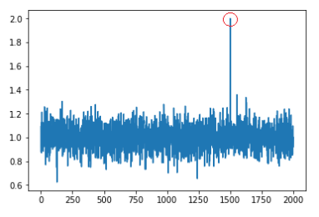
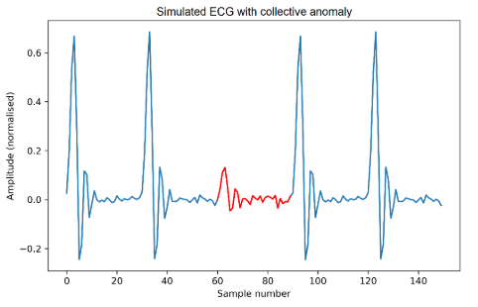
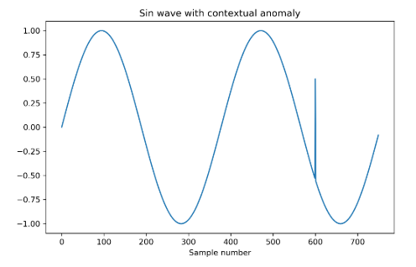
Anomaly Type

Slide 12
Group
Statistical and Probabilistic
Pattern Matching
Distance based
Clustering
Predictive
Ensemble

Slide 13
Methods
Anomaly Detection on Univariate TSD
1) Non-Regressive approaches
LSTM based AE
2) Regression based approaches
ARMA, ARIMA, SARMA, RNN
Anomaly Detection on Multivariate TSD
1) Dimensionality Reduction
PCA, CNN-VAE
2) Clustering
SVM, LOF, MKAD

Slide 14
Dataset Analysis

Slide 15
Yahoo Webscope-S5

Slide 16
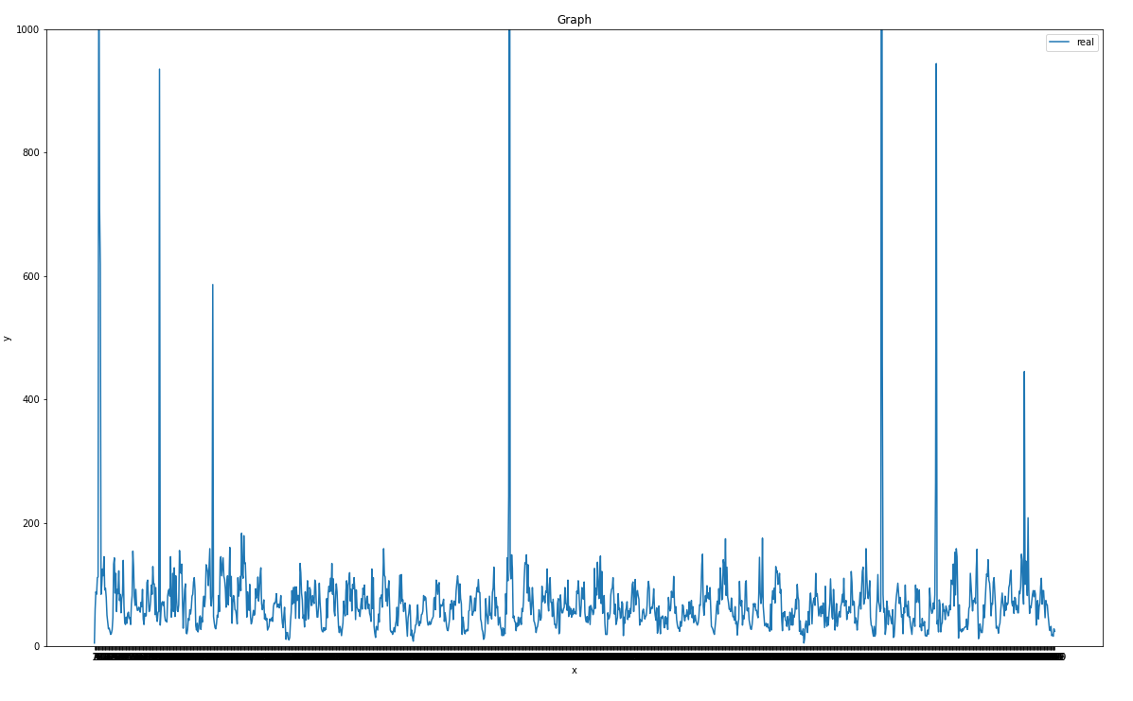
Yahoo Webscope-S5-A1R4

Slide 17
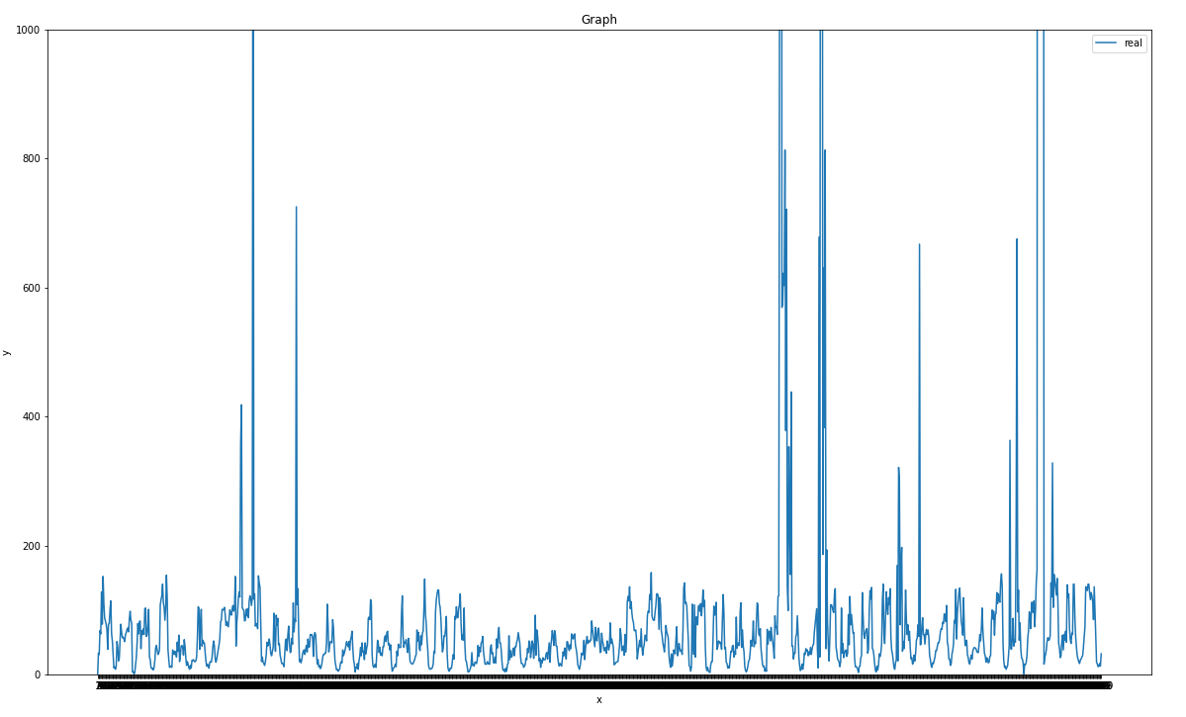
Yahoo Webscope-S5-A1R8

Slide 18
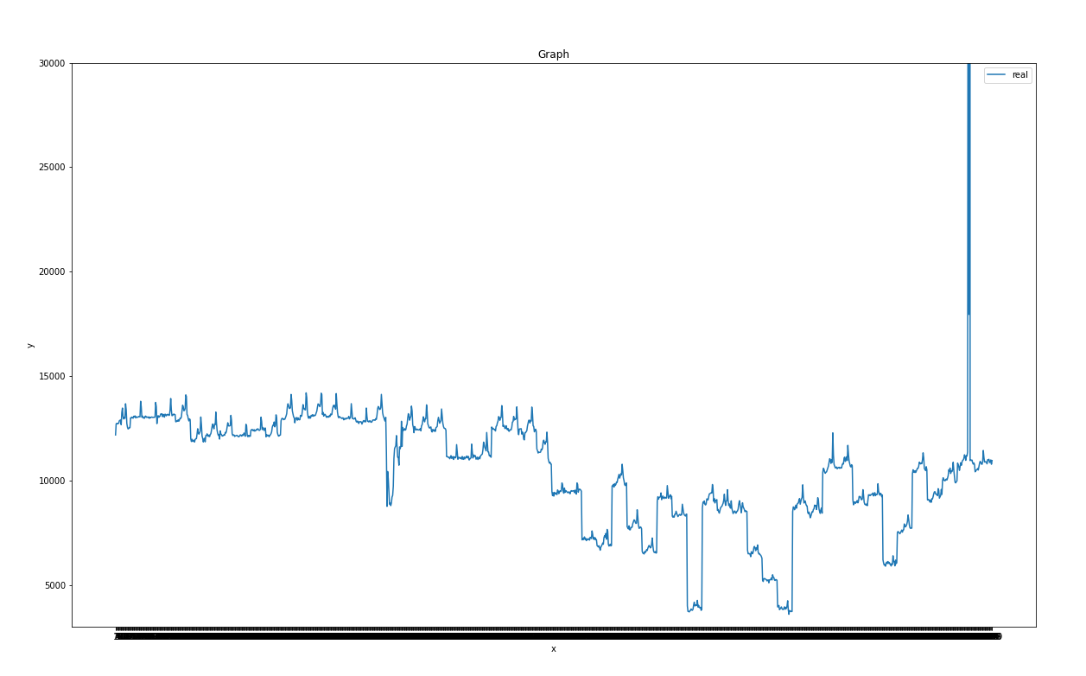
Yahoo Webscope-S5-A1R2

Slide 19
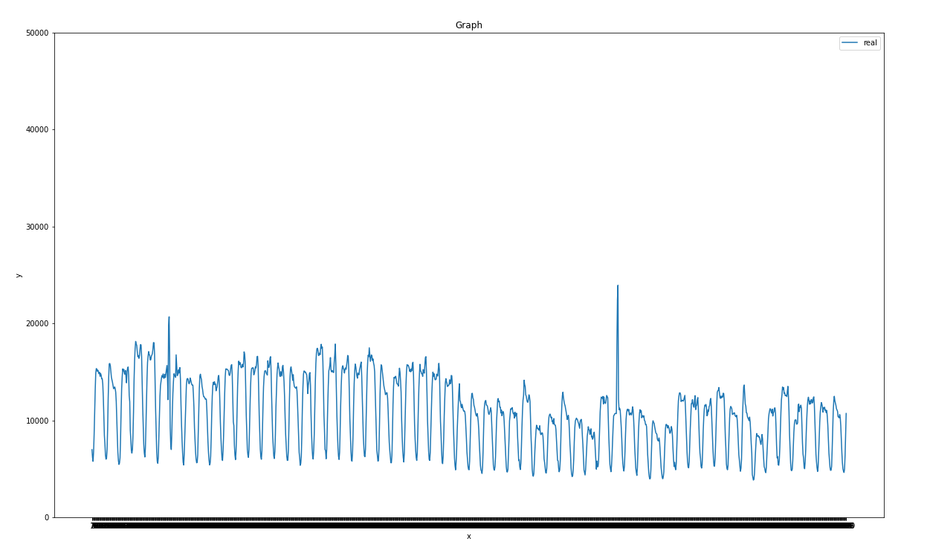
Yahoo Webscope-S5-A1R12

Slide 20
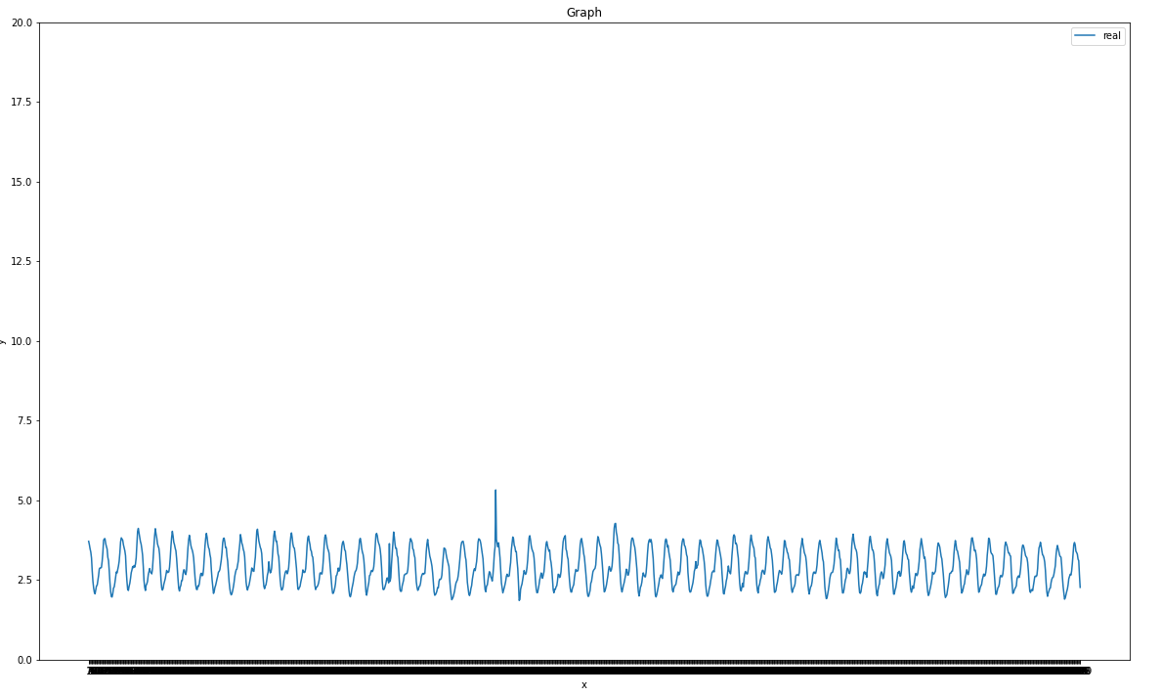
Yahoo Webscope-S5-A1R3

Slide 21
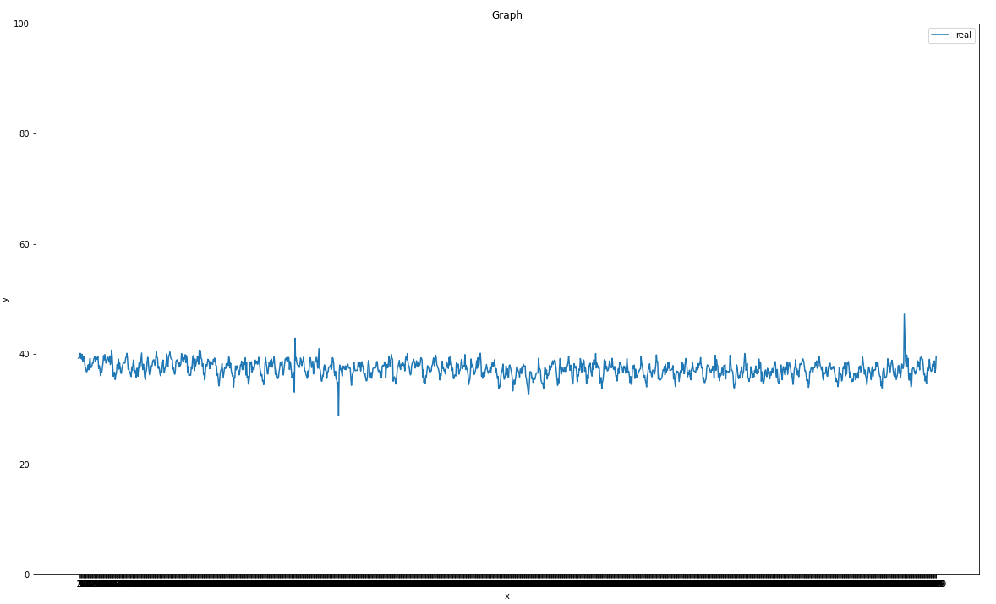
Yahoo Webscope-S5-A1R24

Slide 22
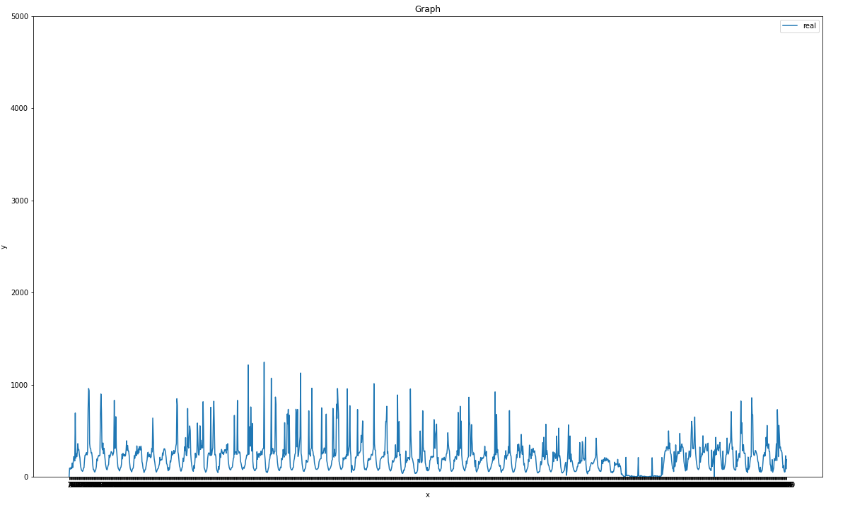
Yahoo Webscope-S5-A1R26

Slide 23
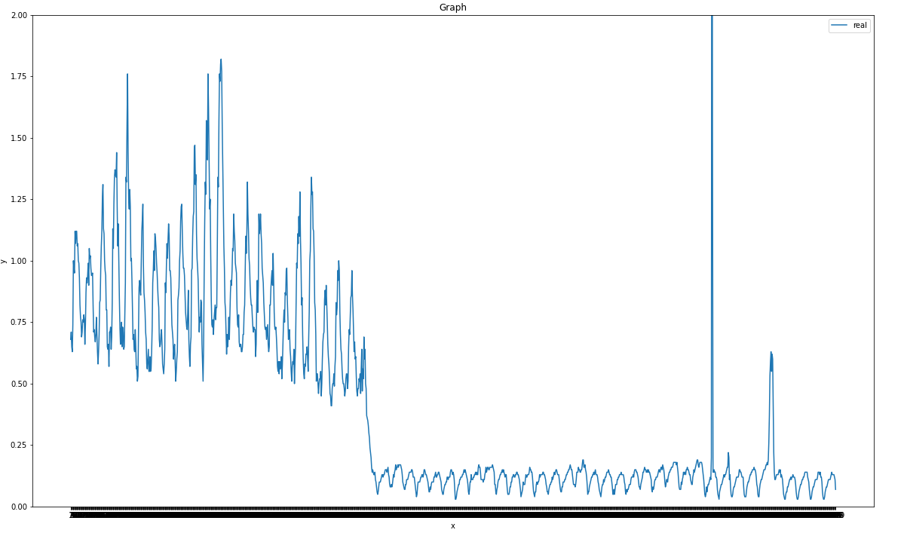
Yahoo Webscope-S5-A1R20

Slide 24
S5-A1
Dataset | Anomaly Point | Recommendation
Real-1 | 1216,1218 | *
Real-2 | 1362-1364 | *
Real-3 | 576 | **
Real-6 | 114 | *
Real-9 | 655-658, 831, 975 | **
Real-10 | no | *
Real-12 | 121 | *
Real-13 | 144-146, 975-977 | **
Real-15 | 144-145, 975-977 | **
Real-16 | 1351-1353 | **

Slide 25
S5-A1
Dataset | Anomaly Point | Recommendation
Real-18 | 423-425 | ***
Real-20 | 1362-1364 | ?
Real-21 | 1281 | *
Real-24 | 425, 1347 | ***
Real-26 | 1080-1158 | ***
Real-27 | 1005, 1308 | *
Real-30 | 1574 | *
Real-33 | no | *
Real-34 | 601, 1020, 1243-1246, 1308 | **
Real-35 | no | *

Slide 26
S5-A1
Dataset | Anomaly Point | Recommendation
Real-36 | 423-426, 607 | ***
Real-38 | 601, 1020-1021, 1307-1312 | ***
Real-39 | 570-574, 647-649, 1021, 1308 | **
Real-40 | 1127-1205, 1308 | ***
Real-44 | 422-427, 574, 607-608 | *
Real-45 | 1262 | **
Real-46 | 858-964, 1068, 1249 | **
Real-47 | 593-596, 601, 1015-1016, 1020-1021, 1308 | *
Real-48 | 361-384 | *
Real-49 | 423-425 | **
Real-50 | no | *

Slide 27
Thanks
@MICC

